Slide 1
LEARN MESH
Where Learners Link and Ideas Thrive.

Slide 2
Team Members
Tulasi Mallampati (G43626084)

Slide 3

About Project
A real-time web application that intelligently forms and manages study groups based on user’s skill levels, availability, and preferred learning styles.

Slide 4
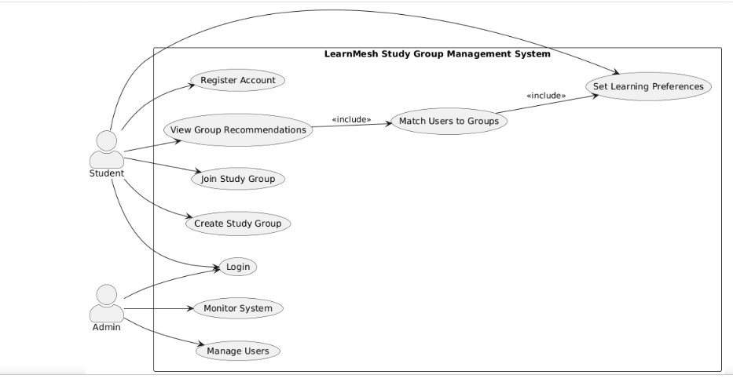
Use Case

Slide 5
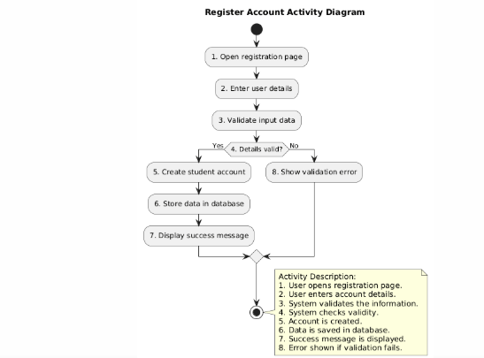
Register Account

Slide 6
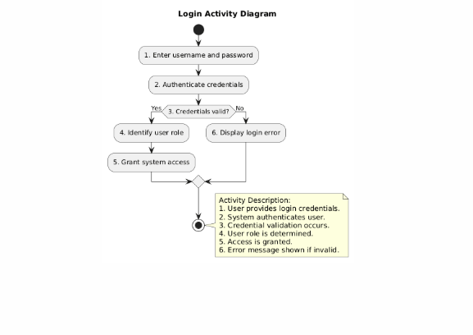
Login

Slide 7
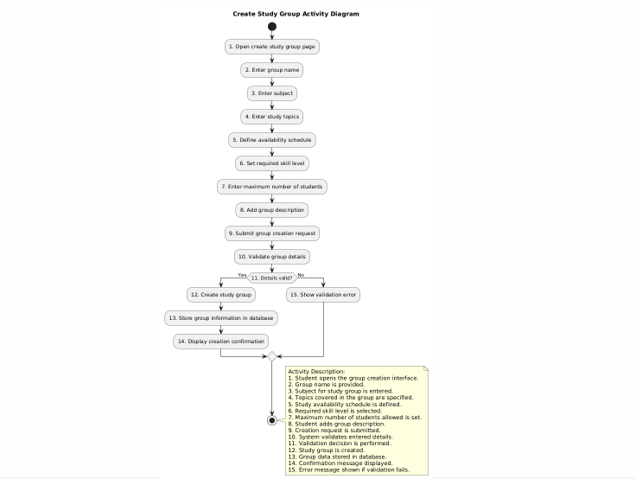
Create Study Group

Slide 8
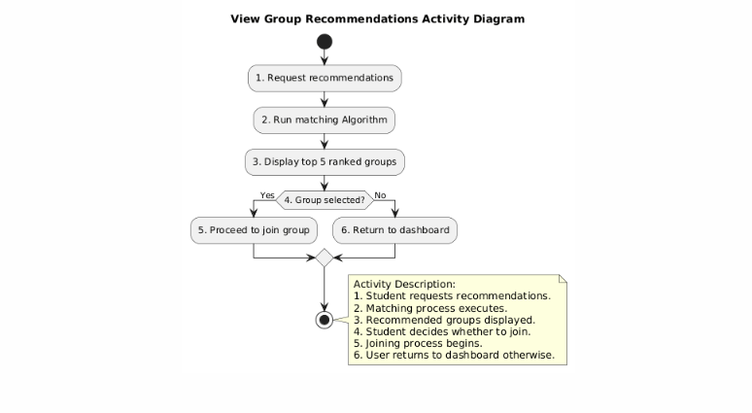
View Group Recommendations

Slide 9
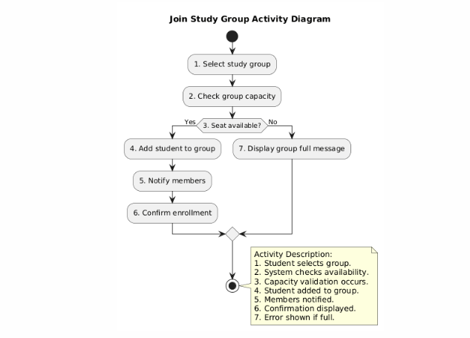
Join Study Group

Slide 10
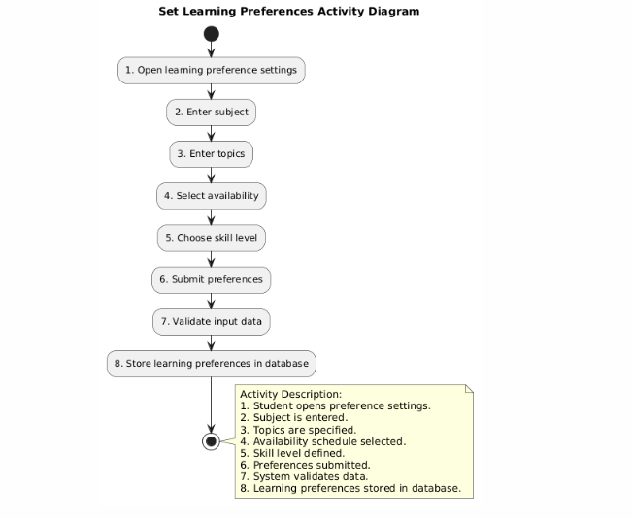
Set Learning Preferences

Slide 11
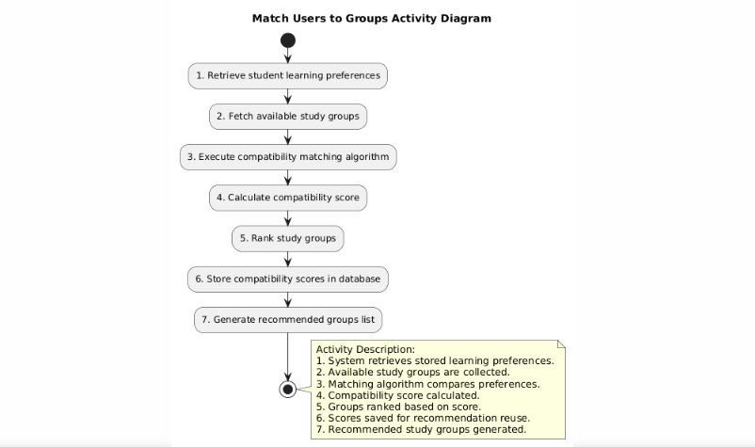
Match Users to Groups

Slide 12
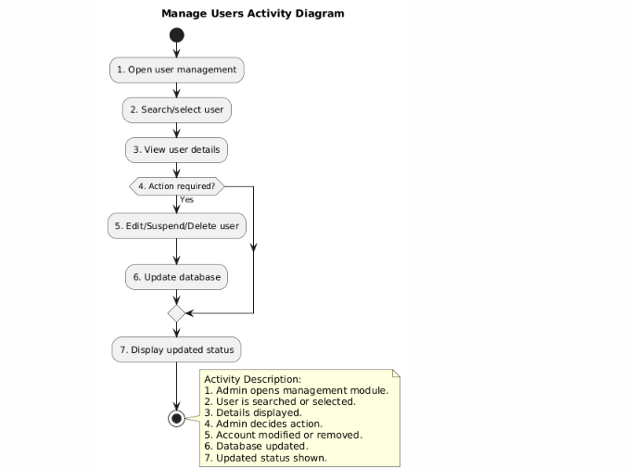
Manage Users

Slide 13
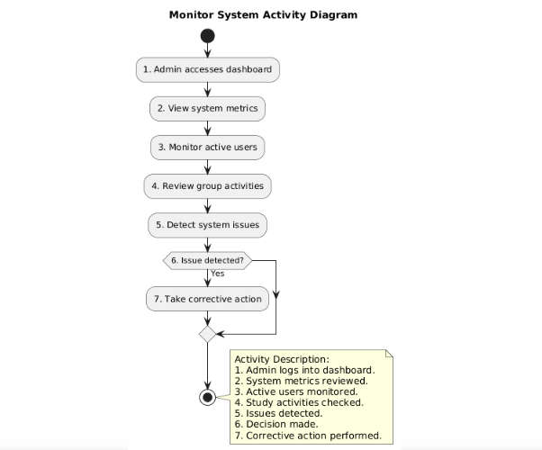
Monitor System

Slide 14
Thank You

